Slide 1
Your Own Game

Slide 2
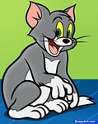
Who is it?
a cat
Back

Slide 3
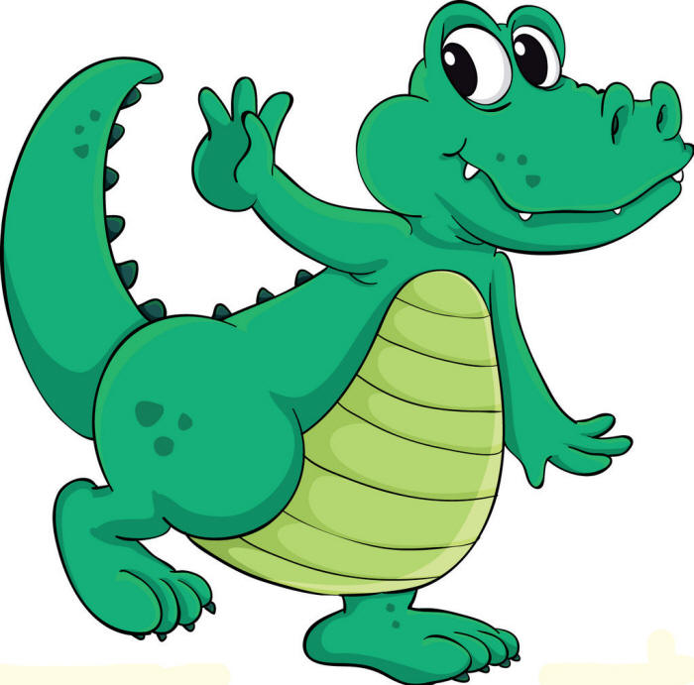
Who is it?
a crocodile
Back

Slide 4
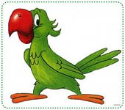
Who is it?
a parrot
Back

Slide 5
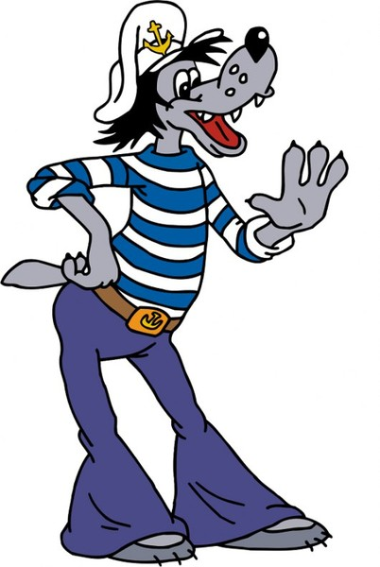
Who is it?
a wolf
Back

Slide 6
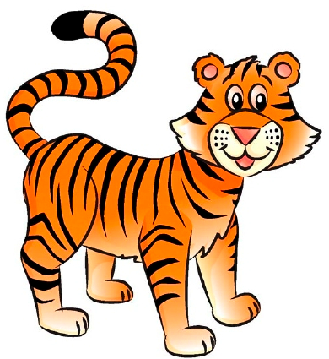
Who is it?
a tiger
Back

Slide 7
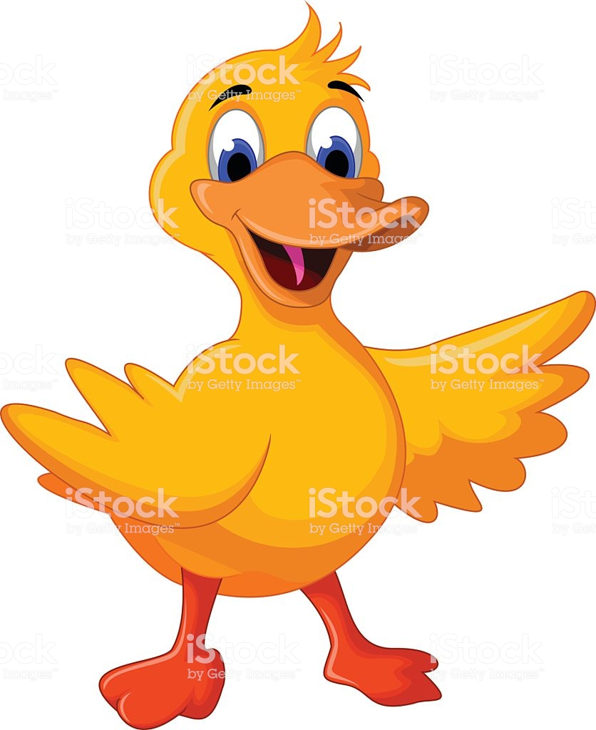
Who is it?
a duck
Back

Slide 8
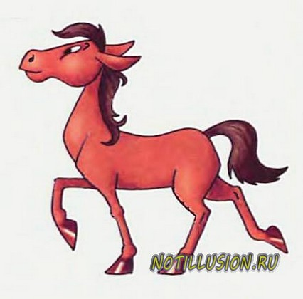
Who is it?
a horse
Back

Slide 9
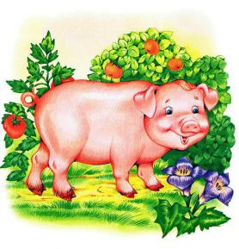
Who is it?
a pig
Back

Slide 10
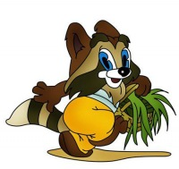
Who is it?
a raccoon
Back

Slide 11
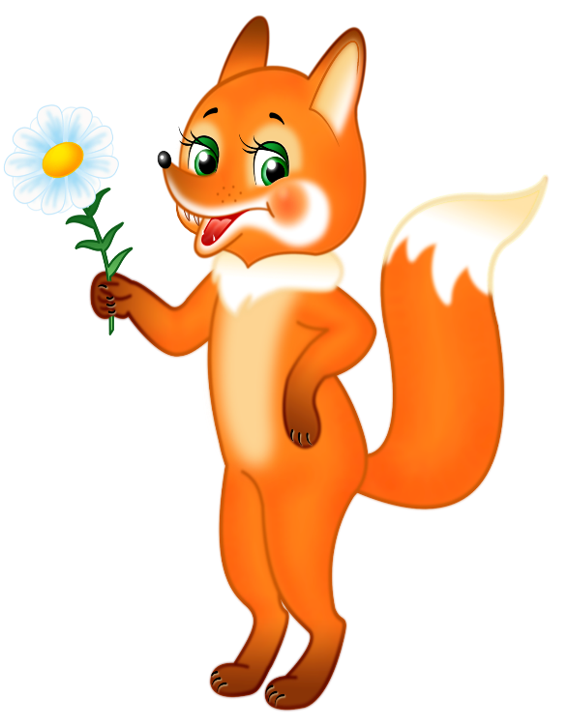
Who is it?
a fox
Back

Slide 12
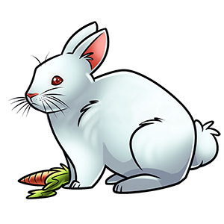
Who is it?
a rabbit
Back

Slide 13
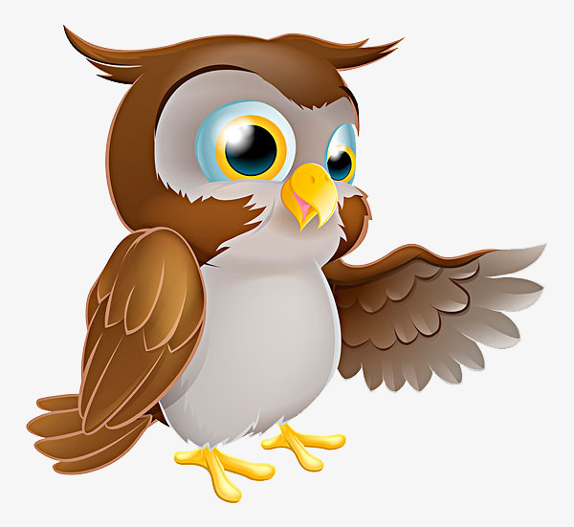
Who is it?
an owl
Back

Slide 14
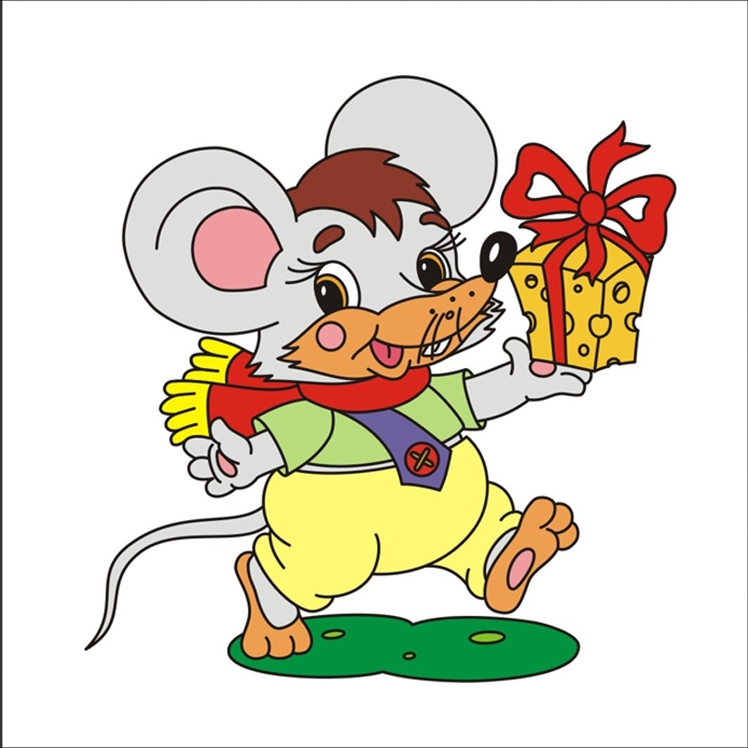
What is it?
a mouse
Back

Slide 15
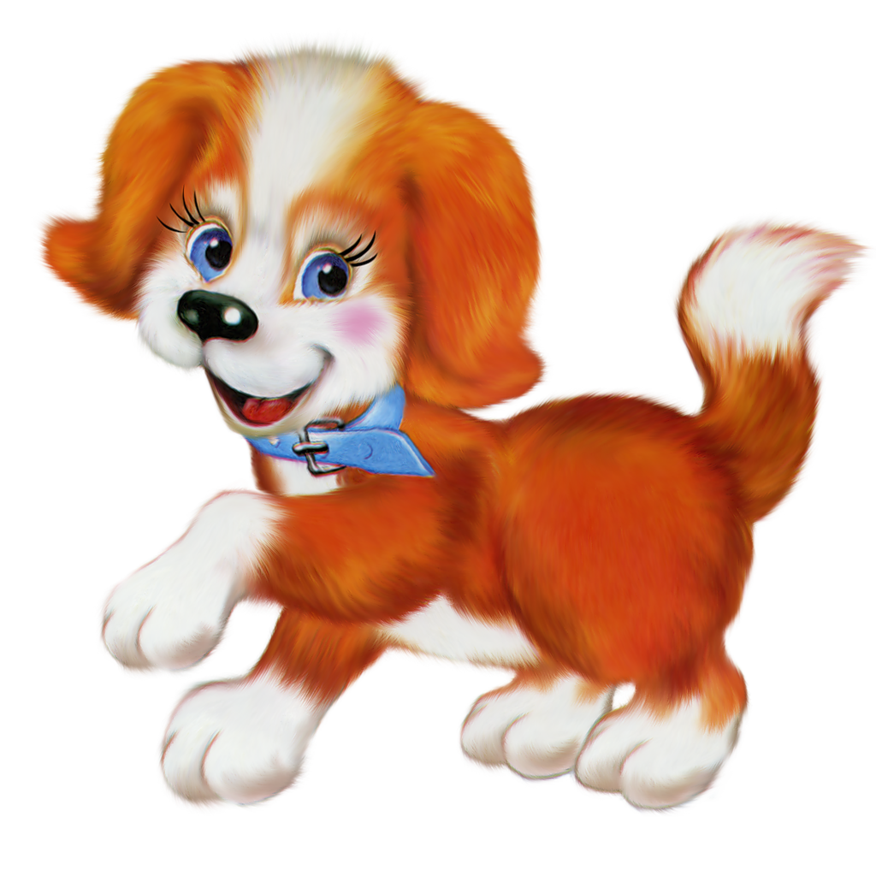
Who is it?
a dog
Back

Slide 16
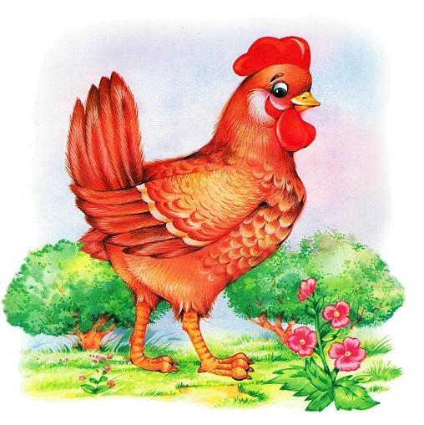
Who is it?
a hen
Back

Slide 17
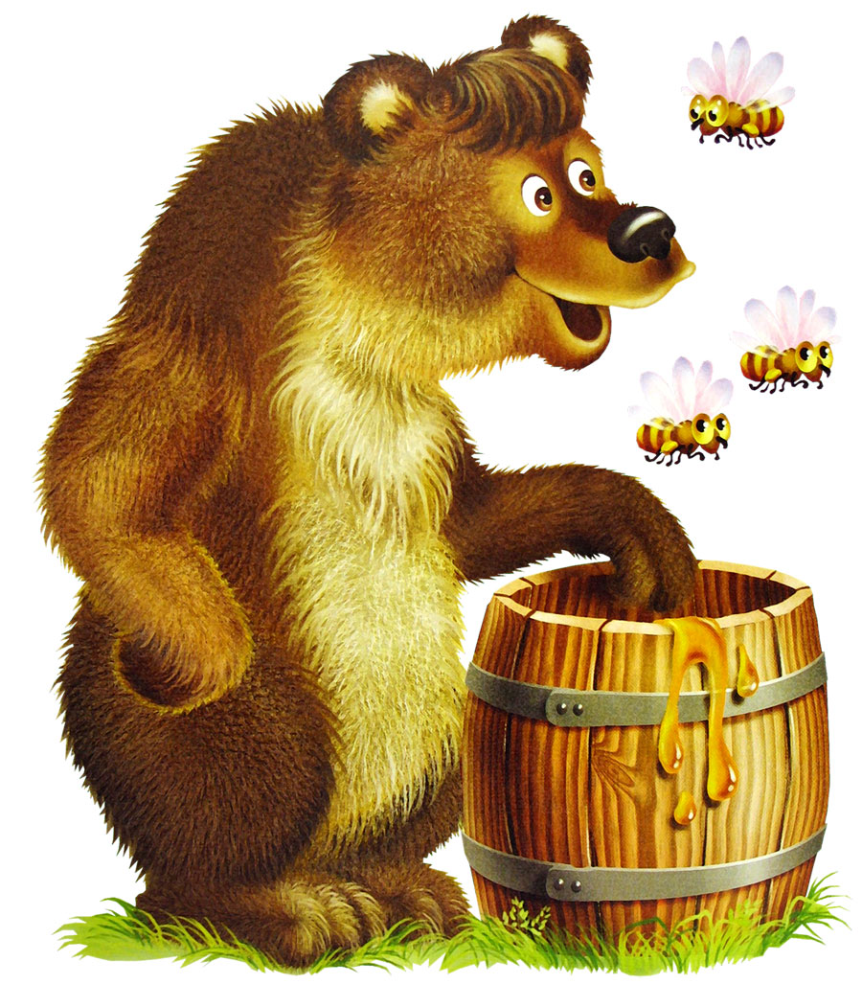
Who is it?
a bear
Back

Slide 18
Yes No
1) Понравилась ли игра?
2) Все ли вы знали?
3) Были слова, которых вы не помнили?
4) Все ли участники команды принимали активное участие в игре?
5) Хотели бы вы еще сыграть в такую игру?

Slide 19
Thank you!

